Slide 1

Visual Quality Indicators Adapted to Resolution Changes
Mikołaj Leszczuk, Dawid Juszka, Filip Korus
Akademia Górniczo-Hutnicza im. Stanisława Staszica w Krakowie
AGH University of Krakow
29.06.2023

Slide 2
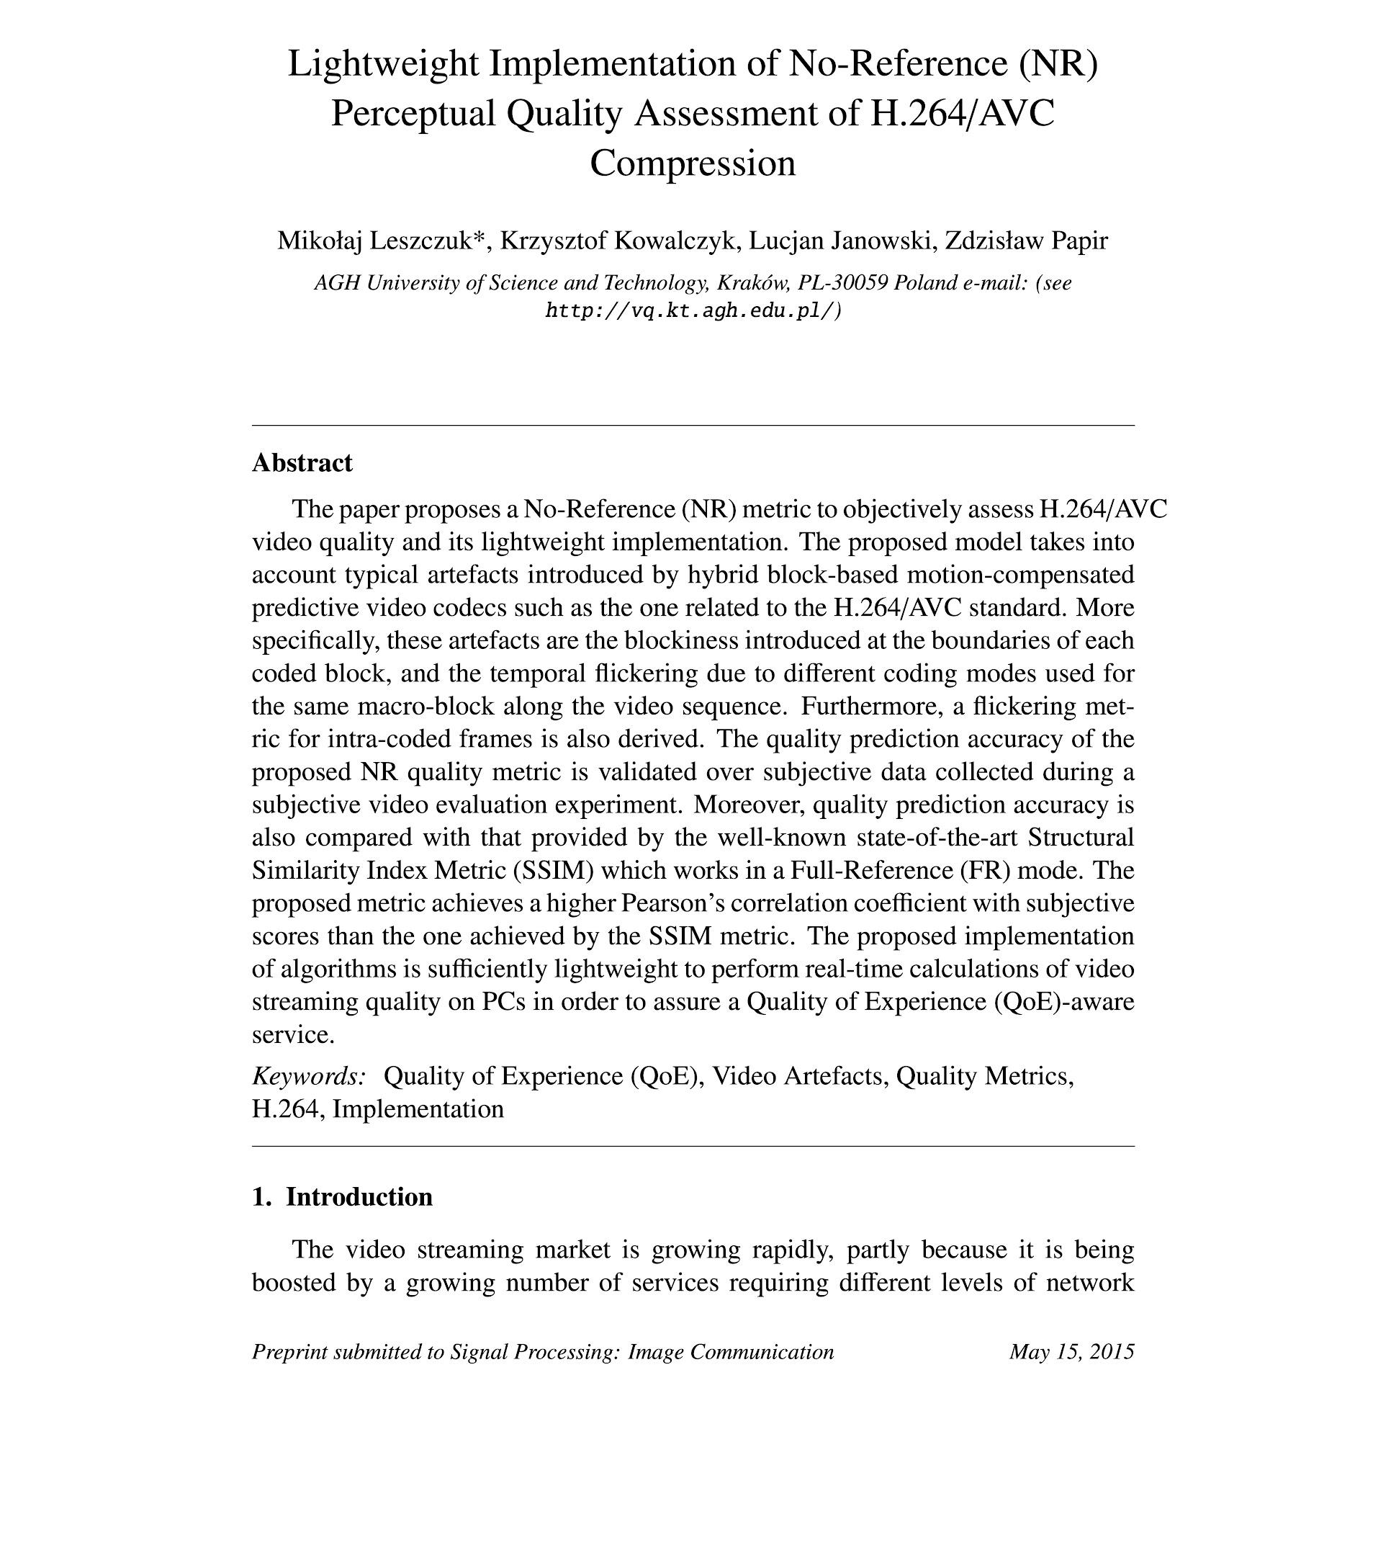
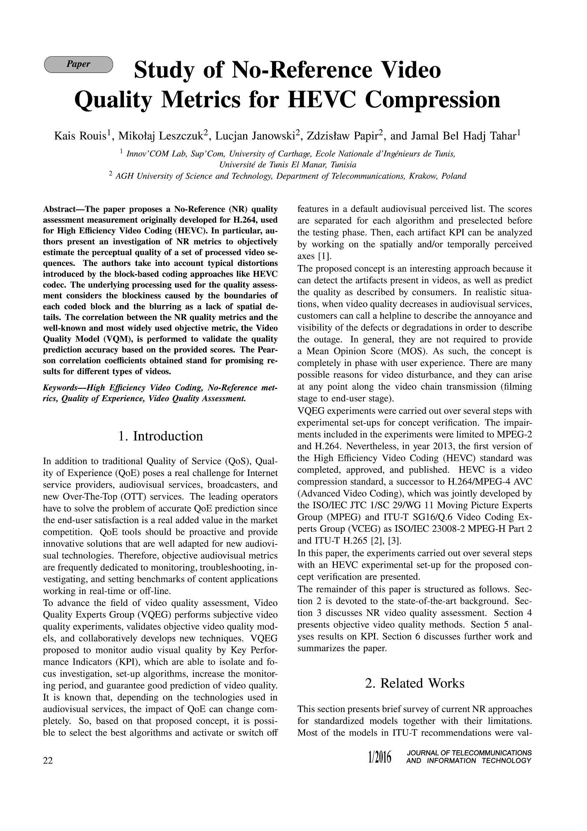
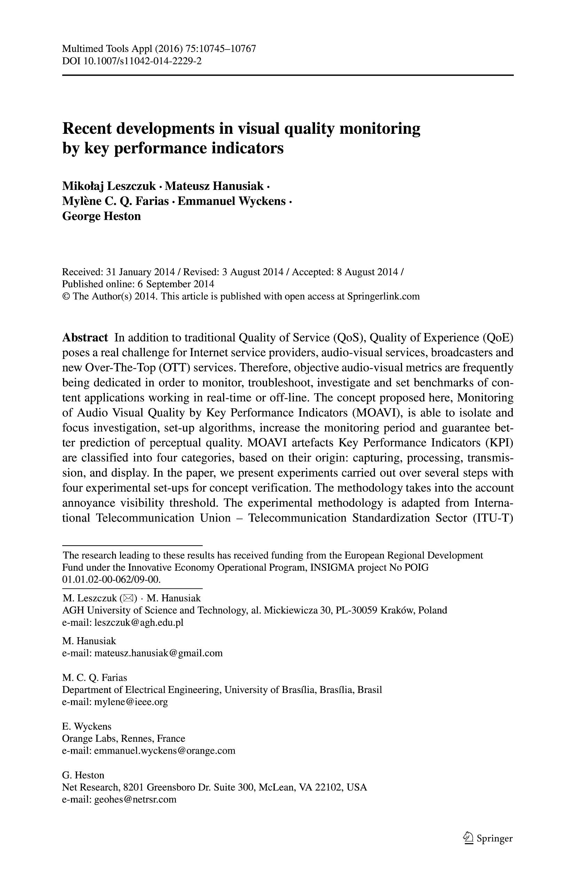
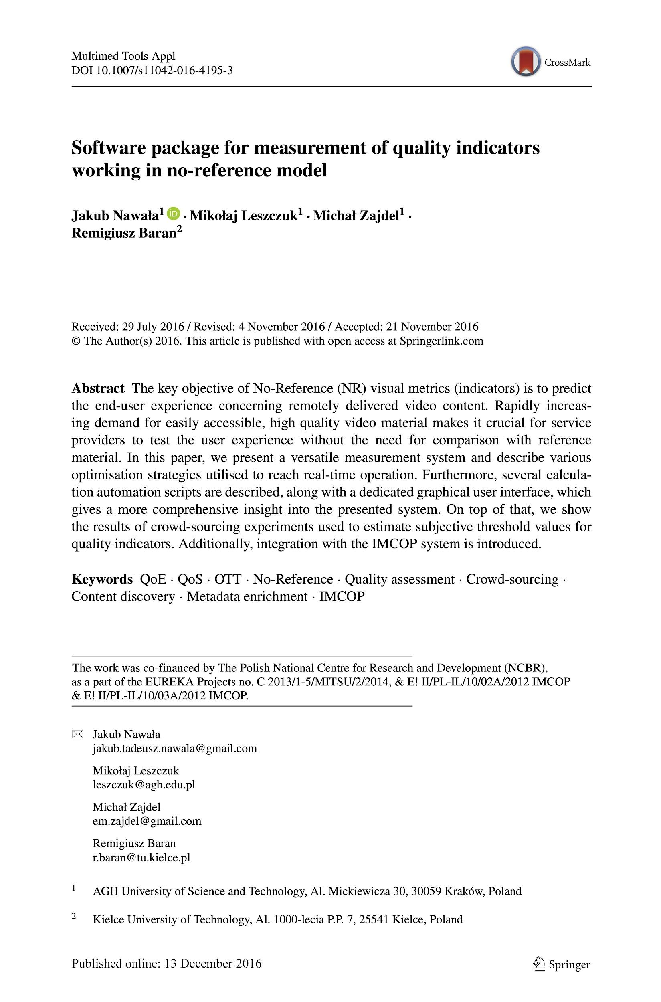
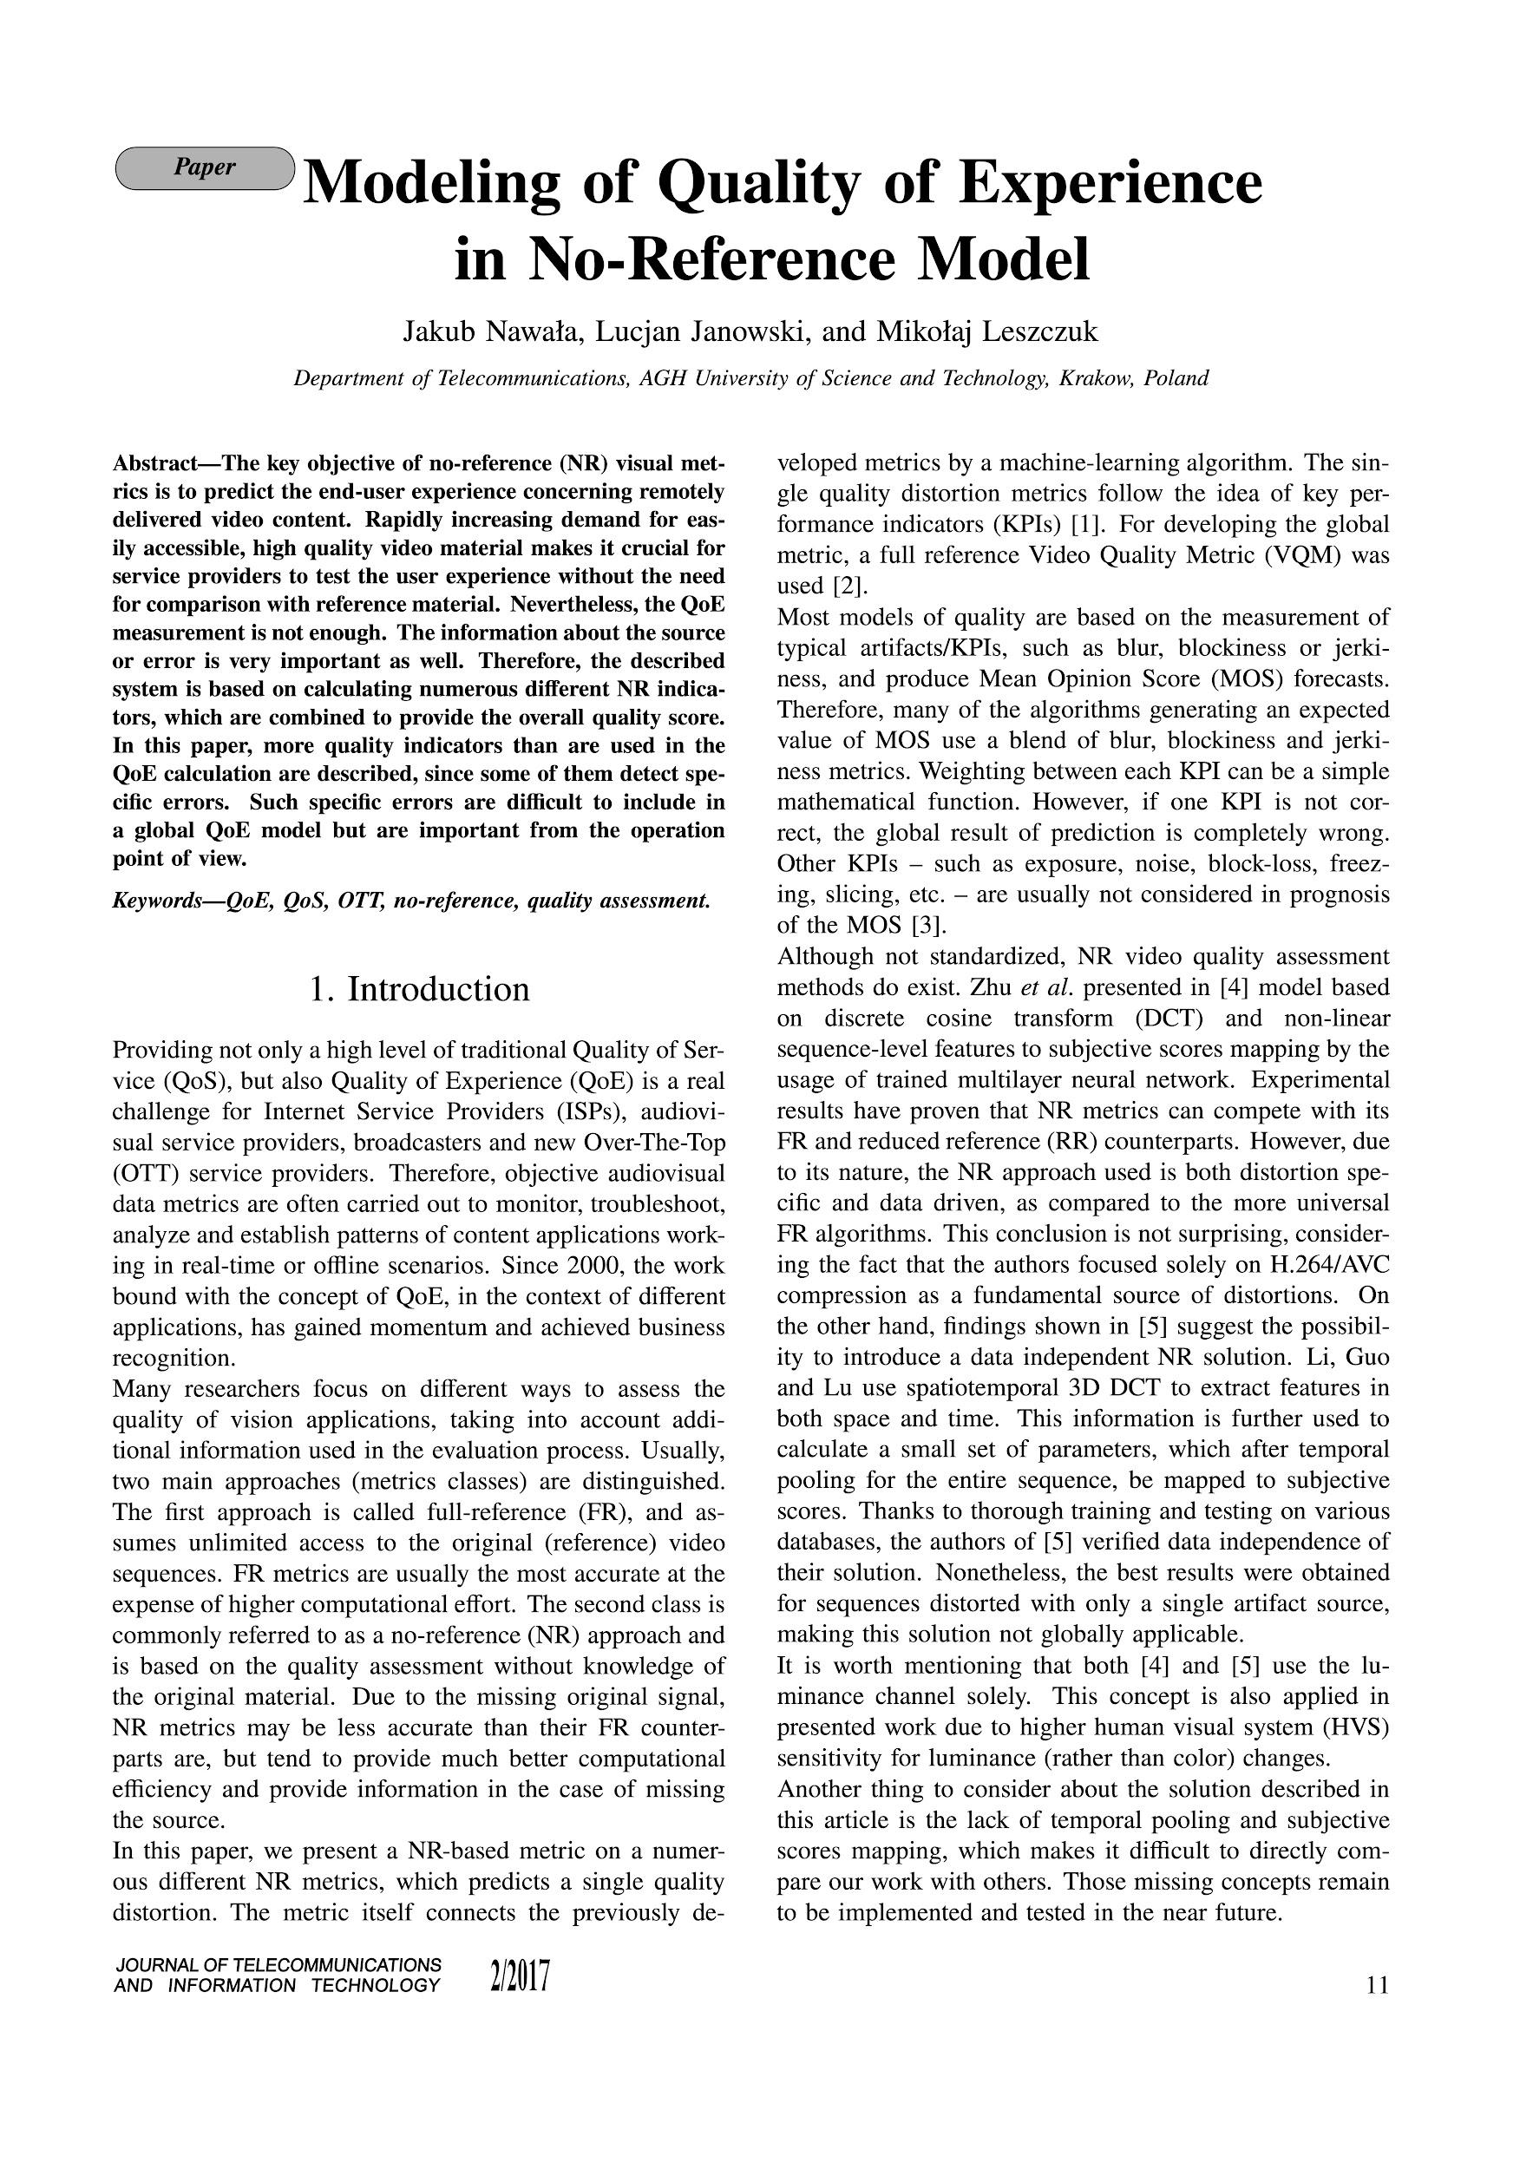
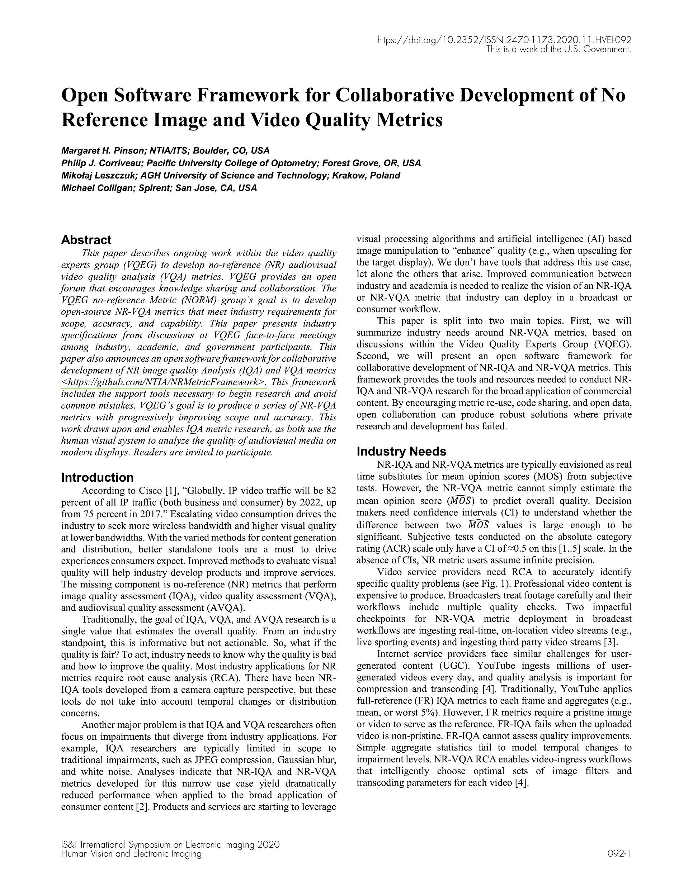
AGH
Visual Quality Indicators

Slide 3

AGH
Visual Quality Indicators
Commercial Black
Blockiness
Block Loss
Blur
Contrast
Exposure
Flickering
Freezing
Interlacing
Letter-boxing
Noise
Pillar-boxing
Slicing
Spatial Activity
Temporal Activity
Colourfulness
Blur Amount

Slide 4

Need and Solution
Increasing number of resolutions

Slide 5
Selected Resolutions
Only common resolutions considered in the models:
240p
360p
480p
720p
1080p
1440p
2160p

Slide 6
Selected Indicators
Selected indicators providing not-Boolean results:
Blockiness
Blur
Exposure (brightness)
Contrast
Interlace
Noise
Slice

Slide 7
Selected SRCs
Selected 10 s long sequences from an available content distributed by:
Cablelabs
  Ancient Thought, Eldorado, Indoor Soccer, Moment of Intensity, Skateboarding, Unspoken Friend, Wipe
Netflix
  Cosmos Laundromat, Nocturne
SJTU_4K
  Bund Nightscape, Campfire Party, Construction Field, Fountains, Library, Marathon, Residential Building, Runners, Rush hour, Scarf, Tall Buildings, Traffic and Building, Traffic flow, Treeshade, Wood
Twitch
  DOTA2, EuroTruck Simulator, Fallout 4, GTA V, Hearthstone

Slide 8
Building Models
Indicators calculations for each PVS (SRCs x bitrates)
Merging results for each resolution
Building a prediction models for each pair of resolutions
XGBoost for Regression
Decided to accept cases for which Pearson correlation coefficient is higher than 0.8
Number of such cases: 112
Unfortunately, not all cases fulfills Pearson correlation coefficient higher than 0.8

Slide 9
Casting Chosen Indicators for Different Resolutions
Blockiness: 1080p-2160p
Blur: 240p-2160p
Contrast: 240p-2160p
Exposure (brightness): 240p-2160p
Interlace: 240p-1080p
Noise: 240p-2160p

Slide 10
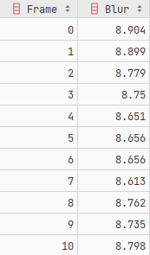
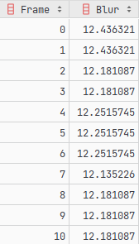
agh_vqis pip Package
Our public pip package now extended with
casting chosen indicators for different resolutions!
from agh_vqis import process_single_mm_file, CastVQI, DestResolution
from pathlib import Path
process_single_mm_file(
Path('video.mp4'),
options={
CastVQI.blur: DestResolution.p2160
}
)
  Fragment of result CSV file showing Blur values for original resolution (1080p).
  …and for 2160p

Slide 11
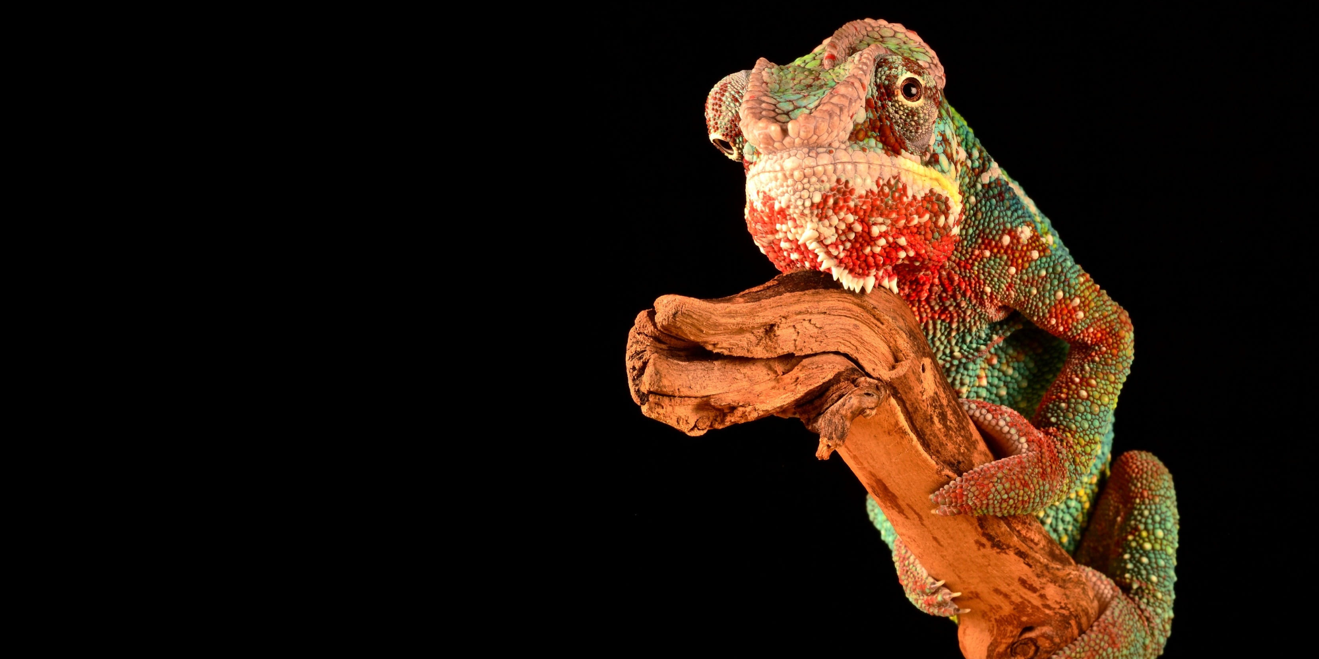
All Your References, Ideas, Discussion Are Welcome!
https://qoe.agh.edu.pl
qoe@agh.edu.pl

